Slide 1

AI Generated Image
Detection
Under the Guidance of
Mr.V. Roshan Kumar – Assistant Professor
Team Members :
S. Susmitha – Y22ACM478
V. Naga Pujitha – Y22ACM485
P. Gopi Chand – Y22ACM463
Y. Surendra – L23ACM502

Slide 2
Contents
01
Abstract & Overview
02
Problem Statement
03
Project Objectives
04
System Architecture
05
Workflow
06
Dataset & Preprocessing
07
Model Architecture
08
Training Process
09
Results
10
Interface & Report Generation
11
Key Improvements
12
Conclusion

Slide 3
Abstract
This project focuses on detecting AI-generated and real images using a Convolutional Neural Network. The model performs automatic feature extraction and binary classification using sigmoid activation. It is trained using binary crossentropy loss and Adam optimizer. The system is integrated with a Gradio interface to provide real-time predictions along with confidence scores.
CNN Model
Feature Extraction
Binary Classification
Gradio Interface
Deep Learning Architecture
Automatic Learning
Real vs AI-Generated
Real-time Predictions

Slide 4
Problem Statement
Highly Realistic
Human Detection Unreliable
AI-generated images are becoming increasingly realistic and difficult to identify visually.
Manual detection methods are inconsistent and leads to errors.
Difficult to Distinguish
Visual inspection alone is no longer sufficient to differentiate real from AI-generated content.
The Solution
Need for automated AI-based detection system that can accurately classify images with high confidence.
Security Risks
Misinformation and security threats arise from undetected AI-generated content.

Slide 5
Objectives
Build CNN-based Classifier
Real vs AI Classification
Learn Features Automatically
Develop a robust Convolutional Neural Network architecture for image classification.
Perform binary classification to distinguish between authentic and AI-generated images.
Enable the model to automatically extract and learn relevant image features.
Evaluate Model Performance
Deploy Using Gradio Interface
Generate Prediction Reports
Assess model accuracy, loss, and overall performance through comprehensive metrics.
Create an interactive web interface for easy model access and predictions.
Produce detailed reports with prediction results and confidence scores.

Slide 6
System Architecture
Input Image
Preprocessing
CNN Model
Prediction
User uploads image
Resize & Normalize
Feature extraction
Result & Confidence
System Workflow: System processes input image through preprocessing, CNN model, and outputs prediction via interface.

Slide 7
Workflow
1
2
3
4
5
6
7
Input
Resize
Normalize
CNN
Dense
Sigmoid
Output
Input Image
Resize 32×32
Normalize 0–1
CNN Extraction
Dense Layer
Sigmoid Output
Threshold Classify
Raw image data from user
Standardize dimensions
Scale pixel values
Feature learning
Classification processing
Probability score
Final prediction

Slide 8
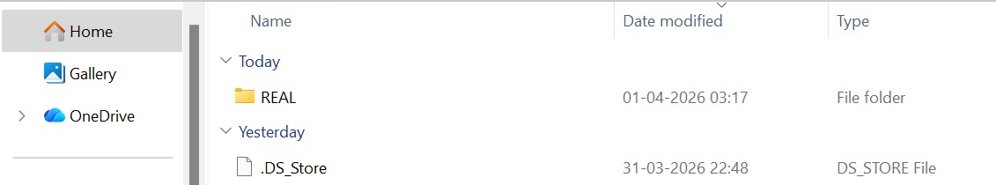
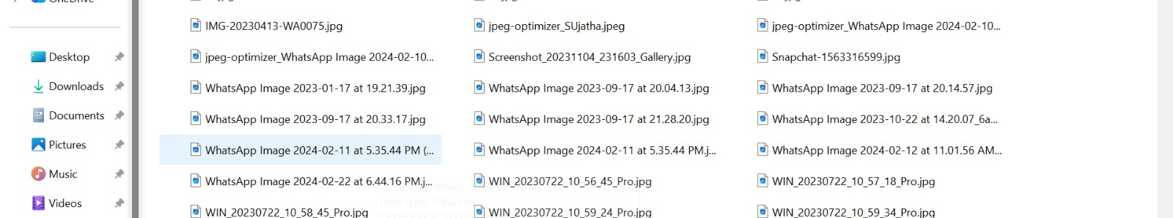
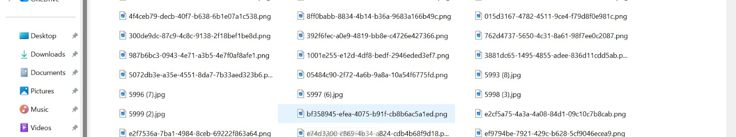
Dataset & Preprocessing
Dataset Structure
REAL vs FAKE images organized in separate directories for supervised learning.
Dataset Folder Structure
Directory-based Labeling
Automatic label assignment based on folder structure for training data.
Image Resizing (32×32)
Standardize all images to uniform dimensions for consistent model input.
REAL Images Collection
Normalization (0–1)
Scale pixel values to range [0,1] for improved model convergence.
FAKE Images Collection
Train/Val/Test Split
Stratified data division for training, validation, and testing phases.

Slide 9
Model Architecture
Conv2D Layers
model.summary()
Feature extraction from input images
ReLU Activation
Introduces non-linearity to the model
MaxPooling
Dimension reduction and downsampling
Flatten Layer
Convert 2D features to 1D vector
Dense Layer
Fully connected classification layer
Sigmoid Output
Probability score [0,1] output

Slide 10
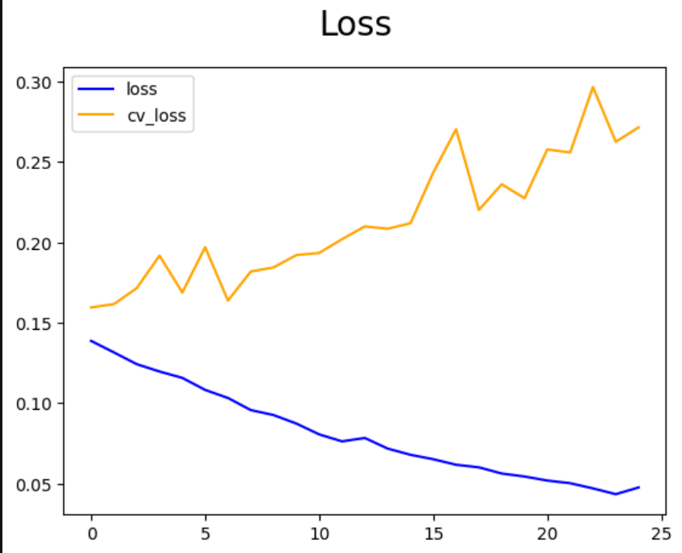
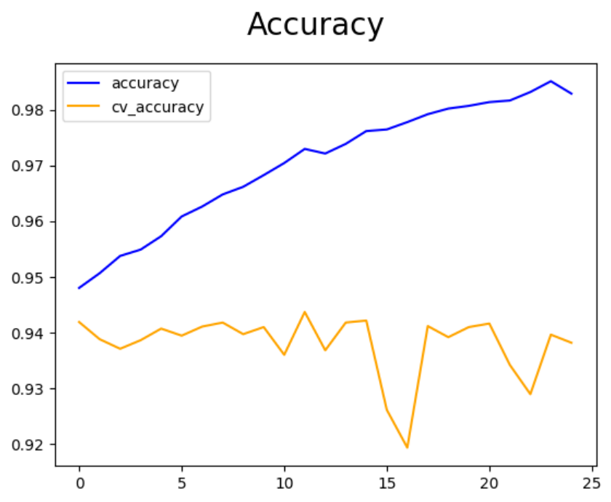
Training Process
Training Loss
Loss: Binary Crossentropy
Appropriate loss function for binary classification tasks measuring prediction error.
Optimizer: Adam
Adaptive learning rate optimizer for efficient gradient descent and faster convergence.
Training Accuracy
Epoch-based Training
Iterative training over multiple epochs to minimize loss and improve accuracy.
Validation Monitoring
Track validation metrics to prevent overfitting and ensure generalization.

Slide 11
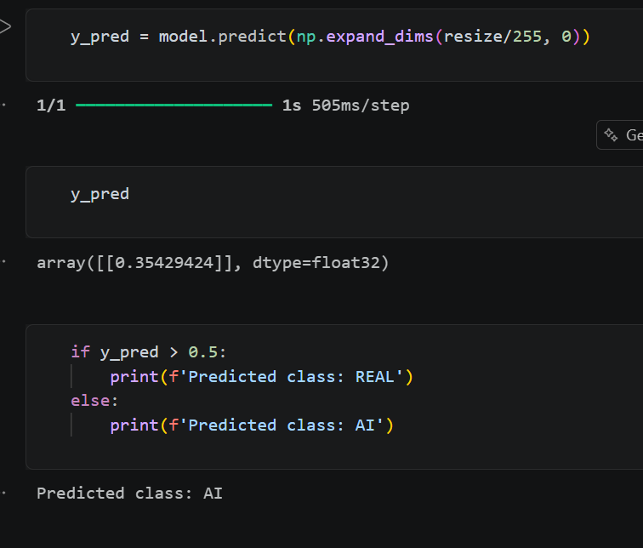
Results
Prediction Output
Probability Score
Model predicts probability score indicating likelihood of image being AI-generated or real.
Tested on Unseen Images
Model evaluated on new, previously unseen images to verify generalization capability.
Successful Classification
Successfully classifies both Real and AI-generated images with high accuracy.

Slide 12
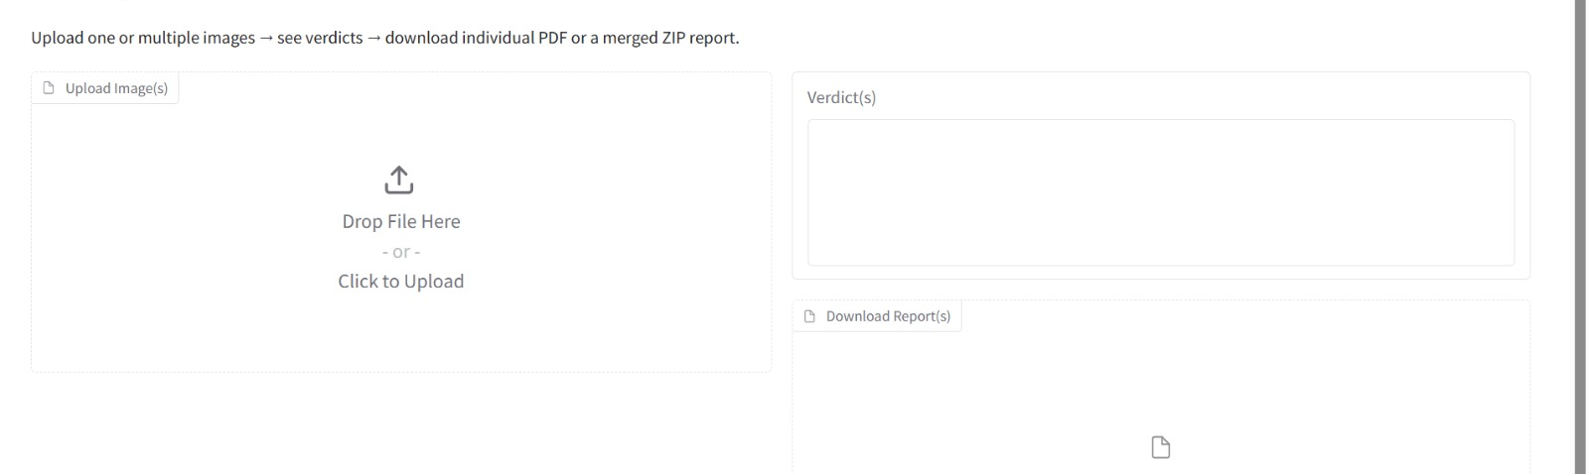
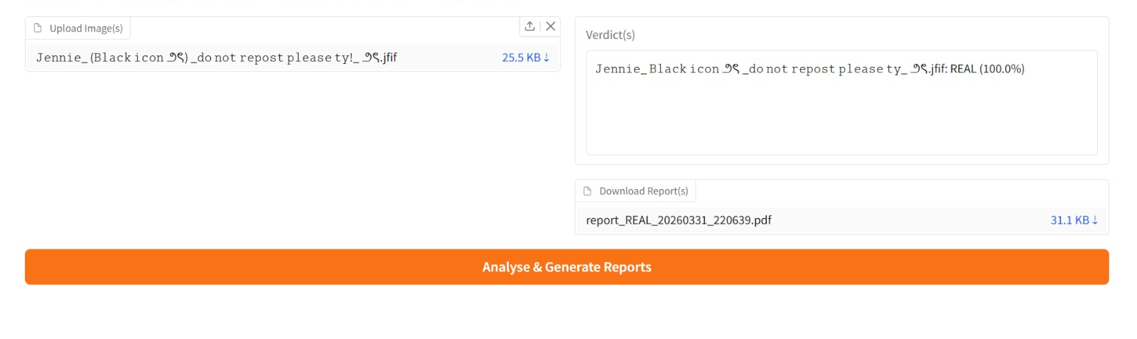
Gradio Interface
Upload Image
Before - Upload Interface
Users can easily upload images through the intuitive drag-and-drop interface.
Model Processes Input
CNN model automatically processes the uploaded image through the pipeline.
Displays Result Instantly
After - Prediction Result
Real-time prediction results displayed immediately after processing.
Shows Confidence Score
Probability score provides transparency and confidence in predictions.

Slide 13
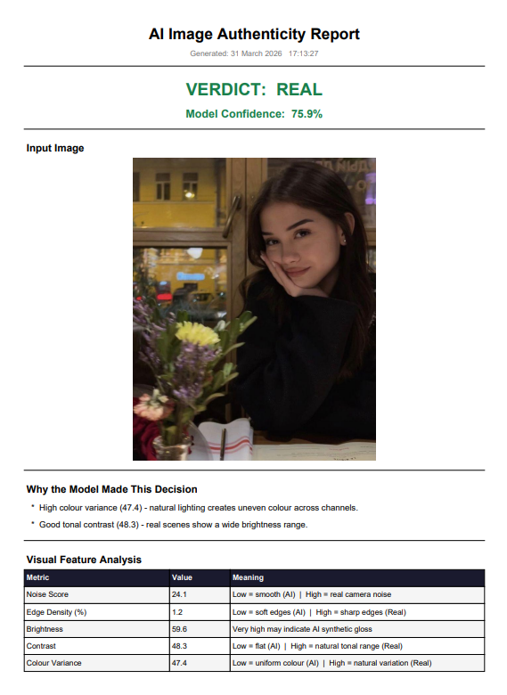
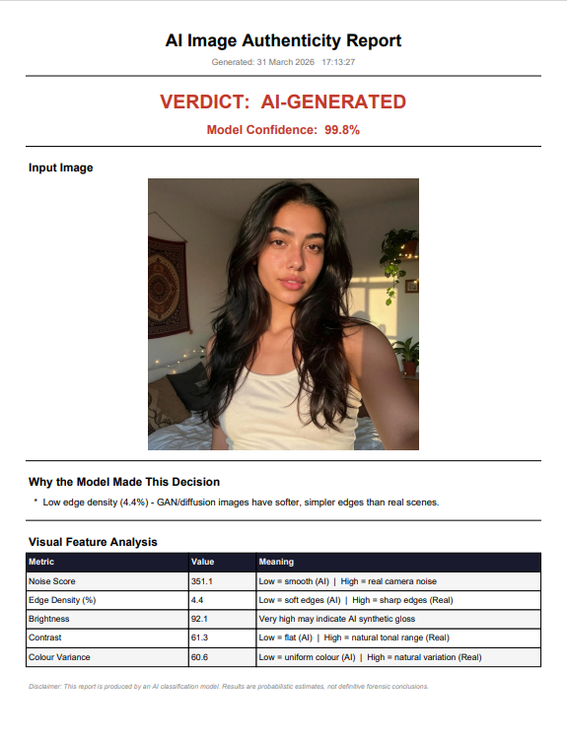
Report Generation
REAL Image Report
AI-GENERATED Image Report
Prediction Result
Displays clear classification result: REAL or AI-GENERATED.
Probability Score
Shows confidence percentage for the prediction decision.
Improved Interpretability
Detailed explanations enhance understanding of model decisions.

Slide 14
Improvements
Earlier
Now
Limited Scope
Model testing completed
Only model training was completed without testing or deployment.
Real-time predictions implemented
Gradio interface added
Report generation implemented

Slide 15
Challenges
Dataset Quality Issues
Overfitting
Image Size Selection
Ensuring high-quality, balanced dataset with diverse real and AI-generated samples.
Preventing model from memorizing training data instead of learning general patterns.
Choosing optimal input dimensions balancing detail preservation and computational efficiency.
Understanding Predictions
Model Integration
Interpreting model decisions and explaining why certain classifications were made.
Seamlessly integrating trained model with Gradio interface for user-friendly deployment.

Slide 16

Conclusion
The project successfully demonstrates AI-based image classification using CNN. The model learns image patterns effectively and provides real-time predictions through a user-friendly interface. This system can help in detecting AI-generated content and improving digital authenticity.
CNN Model
Real-time
User-friendly
Authenticity
Effective feature learning
Instant predictions
Gradio interface
Digital trust

Slide 17
Thank You For Your Attention

